Slide 1
THE CRITICAL THINKING LEVELS TENDENCY OF TEACHER CANDIDATES IN RELIGION EDUCATION
Dr. Hacer Âşık Ev
Celal Bayar University
Faculty of Theology
Department of the Education of Religion and Ethics in Primary School
Turkey
hacerev@gmail.com

Slide 2

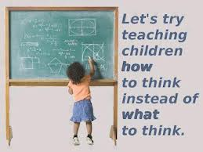
Teacher Candidates of Religion Education and Critical Thinking
The role and the required qualifications of the teacher must continuously be examined and improved according to the needs of the era.
The most important qualification a teacher must have today is “critical thinking”.

Slide 3
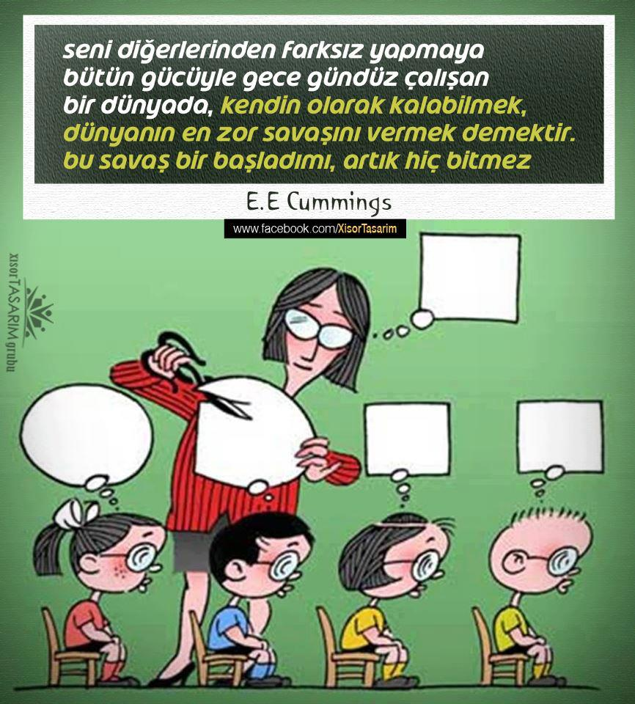
Teacher Candidates of Religion Education and Critical Thinking
According to Ashton, the biggest obstacle in front of the aim for raising individual who think critically in the schools is the fact that teachers are deprived of critical thinking knowledge and abilities.

Slide 4
Teacher Candidates of Religion Education and Critical Thinking
Having the ability of critical thinking and creating an education environment and planning activities for improving such abilities among students is a must for religion education teachers as well.

Slide 5
Teacher Candidates of Religion Education and Critical Thinking
The critical thinking ability of religion education teachers is also important for various fields and perspectives such as the general proficiency of teaching, special field proficiency, the program of DKAB (the Education of Religion and Ethics), training topics and the global world in which we live.
The conditions of global world oblige that a teacher of religion education must have the ability of critical thinking.

Slide 6


Teacher Candidates of Religion Education and Critical Thinking
The ways of living in peace with love and respect with all the members of different religions, cultures and cooperating when it is needed can be thought with education, especially with the education of religion and ethics.

Slide 7


For all these reasons, it must be tried to improve critical thinking abilities of teacher candidates in the processes of education and training.

Slide 8
The Aim of the Study
The aim of this study is to evaluate critical thinking levels of teacher candidates who are freshman students in IDKAB (the department of the Education of Religion and Ethics in Primary School) in Faculty of Theology.

Slide 9
Method, Data Collection and
Data Analysis
In this study, descriptive scanning model has been used.
The inclination of critical thinking levels of religion education teachers candidates is determined with the help of California Critical Thinking Inclination (CCTDI) Scale in Turkish
(CEDEÖ-T).

Slide 10
Method, Data Collection and
Data Analysis
Turkish validity and reliability of the scale is made by Kökdemir in 2003 and the scale consists of 51 articles and 6 sub-scales after adopted in Turkish.

Slide 11
Method, Data Collection and
Data Analysis
The data analysis is evaluated with SPSS 20.0 package program in computer environment.

Slide 12
 | Gender | N | mean
looking for the truth | Female | 40 | 37,8929
 | Male | 50 | 34,2571
open mindedness | Female | 40 | 46,1042
 | Male | 45 | 45,1296
Analyticaln. | Female | 41 | 50,643
 | Male | 49 | 49,7403
systematicity | Female | 39 | 42,2222
 | Male | 50 | 46,3667
self-confidence | Female | 41 | 39,7561
 | Male | 50 | 38,4857
curiousness | Female | 39 | 43,4295
 | Male | 52 | 43,2212
Critical sum | Female | 41 | 253,821
 | Male | 53 | 239,077
Table 1: Gender Variable

Slide 13
Critical Thinking Inclination
According to the Variable of High School Type being Graduated
(Table 2)

Slide 14
Table 3: University Entrane Score
 | Looking for the truth | open mindedness | Analitiklik | systematicity | self-confidence | curiousness | Critical sum
Score | -,216* | -0,061 | -,243* | -,245* | -0,162 | -,282* | -0,095
P | 0,046 | 0,587 | 0,024 | 0,023 | 0,133 | 0,008 | 0,374
N | 86 | 81 | 86 | 86 | 87 | 87 | 90

Slide 15
Critical Thinking Inclination
According to the Variable of Parent’s Education Level
(Table 4)

Slide 16
Critical Thinking Inclination
According to the Variable of Parent’s Education Level
(Table 5).

Slide 17
Critical Thinking Inclination According to Family Structure Variable
(Table 6)

Slide 18
Critical Thinking Inclination According to the Variable of Economic Situation
(Table 7).

Slide 19
Critical Thinking Inclination According to Variable Where They Live
(Table 8).

Slide 20
Critical Thinking Inclination According to Variable Where and with Whom They Live
(Table 9)

Slide 21
Table 10: Education Type Variable
 | Education Type Variable | N | mean
Looking for the truth | I. | 47 | 35,4103
 | II. | 43 | 36,3787
open mindedness | I. | 47 | 44,5035
 | II. | 38 | 46,9298
Analyticalness | I. | 48 | 50,0947
 | II. | 42 | 50,2165
systematicity | I. | 47 | 44,0071
 | II. | 42 | 45,1587
self-confidence | I. | 48 | 38,5417
 | II. | 43 | 39,6346
curiousness | I. | 47 | 42,0745
 | II. | 44 | 44,6307
Critical sum | I. | 48 | 251,174
 | II. | 46 | 239,596

Slide 22
The Result
In terms of the sub-dimension of “looking for the truth” according to all variables, it is observed that the scores of teacher candidates are low.

Slide 23
The Result
Most of the scores in the dimension of “analyticalness” are high while they are at medium level in the dimension of “systematicity”.
In the dimension of “self-confidence” low scores are observed as well as medium scores:
The scores of Anatolian Religious High School (AIHL) and the other high school graduates, except the children of secondary school gratuate mothers (42,0), the candidates with protective or the other type of families, the ones out of income equals expenses, the ones living in countryside, the ones out of the others staying in religious foundation or community houses and the candidates who study in day-time education are low.

Slide 24
The Result
“critical sum”
all the scores except the ones staying with friends and staying in KYK dorms (below 240) are at medium level.
When university entrance score increases, the scores of “looking for the truth, analyticalness, systematicity and curiousness” decrease

Slide 25
The Result
In terms of the sub-dimension of “looking for the truth” it is seen that the scores of teacher candidates are low according to all variables. Another study can be done on the reasons of that.
It is expected that this research will contribute to the field and it will lead and be a guide for future researches.

Slide 26
Thank you for your attention!
Grazié!

